Slide 1
United States Department of
Health & Human Services
Office of the Assistant Secretary for Preparedness and Response
NDMS AMS Authentication
NDMS Portal Login Instructions
September 5, 2015
ASPR Web Team
HHS/ASPR

Slide 2
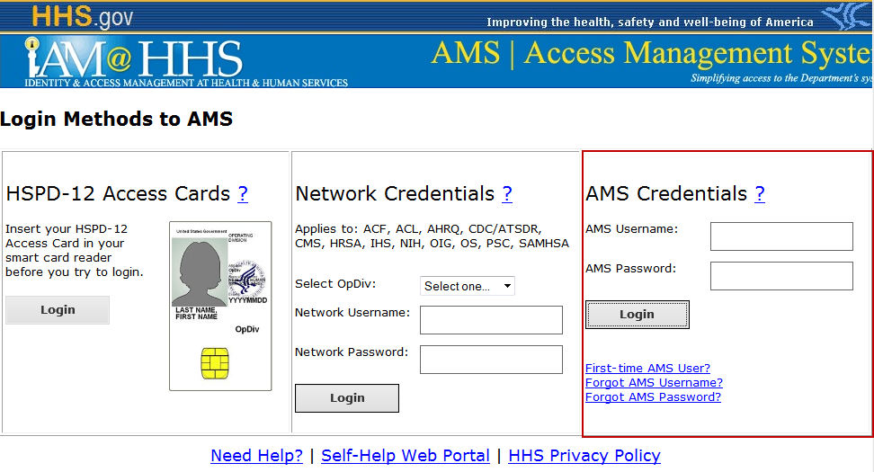
NDMS Access - Accessing the NDMS Portal & My Virtual Desktop
Site Access
The NDMS Portal can be accessed directly at:
https://ndms.hhs.gov
Helpful Hints: To easily access this site, bookmark this site in your browser. You may also use the site navigation tools, described on the pages that follow, once you have entered the site.
Please Note:
To access the NDMS Portal you must use either your AMS user ID and password, or an HHS PIV Card and government machine.
The NDMS Portal is designed to be accessed from anywhere you have an Internet connection using your AMS user ID and password. As a result it is important to keep them up-to-date. Your Password will need to be updated every 60 days.
Your login ID will be your firstname.lastname in all capital letters. If you do not know your AMS Password please scroll over to the AMS Credentials dialog in the AMS Login screen, and choose the third link (ie. Forgot AMS password) to use the first time user option to setup your NDMS AMS user profile.
Login Instructions
If you are accessing the site from a remote location outside the HHS network, you will be prompted to login as a security measure.
Enter your user name and password using the following format – entering in all CAPS may be required:
Username: firstname.lastname
Password: Your AMS Password
Helpful Hint: Your AMS Credential is not the same as your HHSID number and must be setup using the first time AMS user function -if you have not already done so. If you receive 1000 error the credentials typed in are invalid. If you receive a 3003 error, your credentials exist but you did not complete the initial setup process for a first time user. If you receive any of these errors please contact the NDMS Web Support team at http://www.phe.gov/inquiry/pages/NDMSWebteam.aspx for further assistance.
2

Slide 3
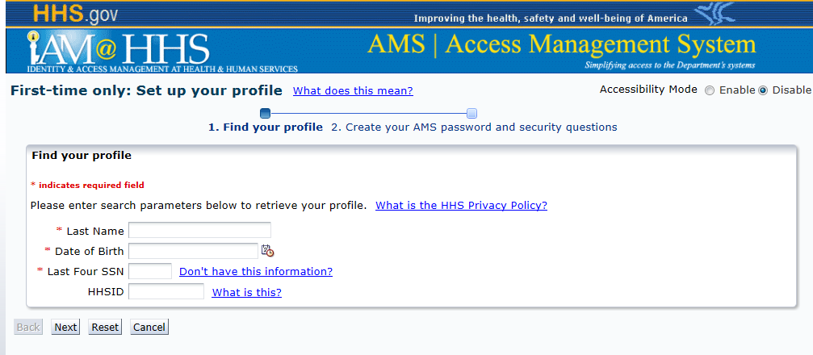
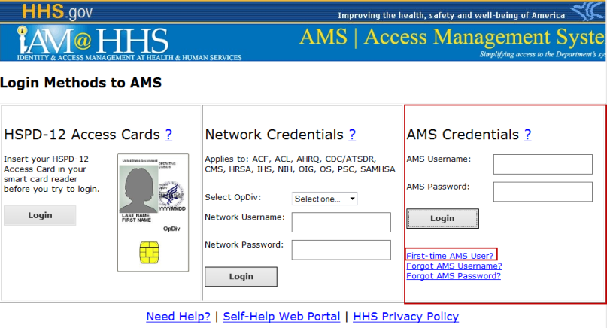
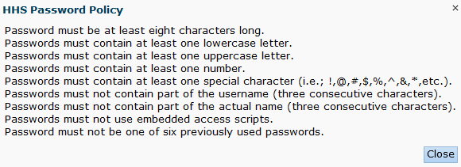
NDMS Access - Accessing the NDMS Portal & My Virtual Desktop
First Time AMS User
If you are a first-time AMS User, you must establish a profile, username and password to access the NDMS Portal.
The first-time user function allows you to complete the set up process for your AMS profile by creating a password and selecting your security (challenge) This process also insures you can use the self-service portal to reset your password.
1) First-time User setup - Choose the First-time AMS User option
Helpful Hints: If you already know your AMS username, please skip this step and login with your AMS user ID and password. If you have a password but do not know your User ID – please use the “Forgot AMS Username option ( beneath the First-time AMS User option), to find out what your username has been set to.
2) Locate your profile - Fill in all required fields to locate your profile.
3) Setup your profile – Select Next once you have entered all required fields to setup your profile.
4) Set your security questions and password- To set your security questions choose the questions from the picklist provided. Your answers will be case sensitive.
To set your password, type in your new password and then type it a second time to confirm. A password must contain the following.
3

Slide 4
NDMS Access - Accessing the NDMS Portal & My Virtual Desktop
Are you having problems setting up your access?
If any technical issues are encountered DO NOT contact the AMS Helpdesk.
Please contact the NDMS Web Helpdesk for expedited support using the url below.
http://www.phe.gov/inquiry/pages/NDMSWebteam.aspx
This url will be accessible even if you do not have a working ID and password. Please include the error message if provided.
4

